Slide 1
THEVENIN & NORTON THEOREMS

Slide 2
Basic Electric Circuits
Thevenin’s and Norton’s
Theorems

Slide 3
THEVENIN’S THEOREM
Consider the following:
A
•
Network1
B
Network2
•
For purposes of discussion, at this point, we considerthat both networks are composed of resistors and independent voltage and current sources
1

Slide 4
Suppose Network 2 is detached from Network 1 and we focus temporarily only on Network 1.
•
A
Network 1
•
B
Figure 2: Network 1, open-circuited.
Network 1 may contains many meshes, resistors, voltage sources and current sourcess
2

Slide 5
•
A
Network1
•
B
Now place a voltmeter across terminals A-B and
read the voltage. We call this the open-circuit voltage.
No matter how complicated Network 1 is, we read one
voltage. It is either positive at A, (with respect to B)
or negative at A.
We call this voltage V_{os} and we also call it V_{THEVENIN} = V_{TH}
3

Slide 6
We now deactivate all sources of Network 1.
To deactivate a voltage source, we remove
the source and replace it with a short circuit.
To deactivate a current source, we remove
the source.
4

Slide 7
Consider the following circuit.
Figure 3: A typical circuit with independent sources
How do we deactivate the sources of this circuit?
5

Slide 8
When the sources are deactivated the circuit appears
as in Figure 4.
Figure 4: Circuit of Figure 10.3 with sources deactivated
Now place an ohmmeter across A-B and read the resistance. If R₁= R₂ = R₄= 20 Ω and R₃=10 Ω then the meter reads 10 Ω.
6

Slide 9
We call the ohmmeter reading, under these conditions, R_{THEVENIN} and shorten this to R_{TH}. Therefore, the important results are that we can replace Network 1 with the following network.
Figure 5: The Thevenin equivalent structure.
7

Slide 10
We can now tie (reconnect) Network 2 back to terminals A-B.
Figure 6: System of Figure 10.1 with Network 1 replaced by the Thevenin equivalent circuit.
We can now make any calculations we desire within Network 2 and they will give the same results as if we still had Network 1 connected.
8

Slide 11
It follows that we could also replace Network 2 with a Thevenin voltage and Thevenin resistance. The results would be as shown in Figure 7.
Figure 7: The network system of Figure 1 replaced by Thevenin voltages and resistances.
9

Slide 12
Example 1.
Find V_{X} by first finding V_{TH} and R_{TH} to the left of A-B.
Figure 8: Circuit for Example 1.
First remove everything to the right of A-B.
10

Slide 13
Figure 9: Circuit for finding V_{TH} for Example 10.1.
Notice that there is no current flowing in the 4 Ω resistor
(A-B) is open. Thus there can be no voltage across the
resistor.
11

Slide 14
We now deactivate the sources to the left of A-B and find
the resistance seen looking in these terminals.
R_{TH}
Figure 10.10: Circuit for find R_{TH} for Example 10.10.
We see,
R_{TH} = 12||6 + 4 = 8 Ω
12

Slide 15
After having found the Thevenin circuit, we connect this
to the load in order to find V_{X}.
Figure 10.11: Circuit of Ex 10.1 after connecting Thevenin
circuit.
13

Slide 16
In some cases it may become tedious to find R_{TH} by reducing
the resistive network with the sources deactivated. Consider
the following:
Figure 12: A Thevenin circuit with the output shorted.
We see;
Eq .1
14

Slide 17
Example 2.
For the circuit in Figure 13, find R_{TH} by using Eq 1.
Figure 13: Given circuit with load shorted
The task now is to find I_{SS}. One way to do this is to replace
the circuit to the left of C-D with a Thevenin voltage and
Thevenin resistance.
15

Slide 18
Applying Thevenin’s theorem to the left of terminals C-D
and reconnecting to the load gives,
Figure 14: Thevenin reduction for Example 2.
16

Slide 19
Example 3
For the circuit below, find V_{AB} by first finding the Thevenin
circuit to the left of terminals A-B.
We first find V_{TH} with the 17 Ω resistor removed.
Next we find R_{TH} by looking into terminals A-B
with the sources deactivated.
17

Slide 20
Circuit for finding V_{OC}
18

Slide 21
19

Slide 22
We can easily find that,
20

Slide 23
NORTON’S THEOREM:
Assume that the network enclosed below is composed
of independent sources and resistors.
Network
Norton’s Theorem states that this network can be
replaced by a current source shunted by a resistance R.
33

Slide 24
In the Norton circuit, the current source is the short circuit current of the network, that is, the current obtained by shorting the output of the network.
The resistance is the resistance seen looking into the network with all sources deactivated. This is the same as R_{TH}.

Slide 25
We recall the following from source transformations.
In view of the above, if we have the Thevenin equivalent
circuit of a network, we can obtain the Norton equivalent
by using source transformation.
However, this is not how we normally go about finding
the Norton equivalent circuit.
34

Slide 26
Example 4.
Find the Norton equivalent circuit to the left of terminals A-B
for the network shown below. Connect the Norton equivalent
circuit to the load and find the current in the 50 Ω resistor.
35

Slide 27
Circuit for find I_{NORTON}.
It can be shown by standard circuit analysis that
36

Slide 28
It can also be shown that by deactivating the sources,
We find the resistance looking into terminals A-B is
R_{N} and R_{TH} will always be the same value for a given circuit.
The Norton equivalent circuit tied to the load is shown below.
Figure 10.32: Final circuit for Example 10.6.
37

Slide 29
circuits
End of Lesson, Thevenin's and Norton

Slide 30
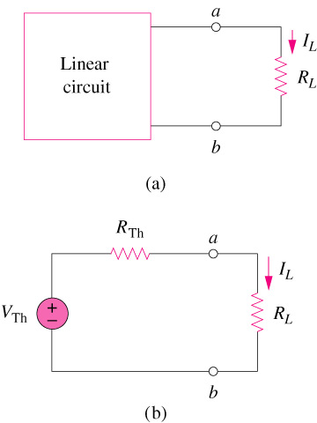
=
A simple voltage divider

Slide 31
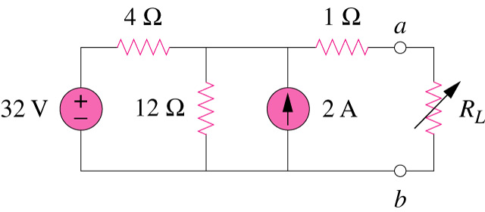
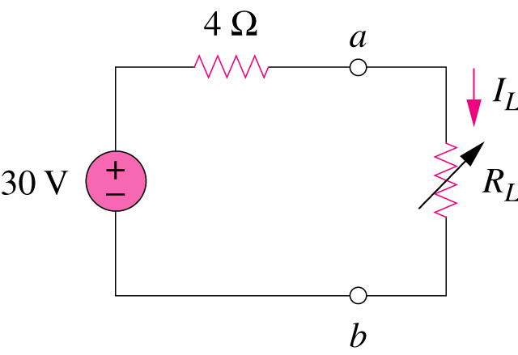
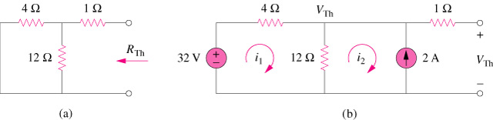
Example 1
R_{Th}
=
V_{Th}

Slide 32
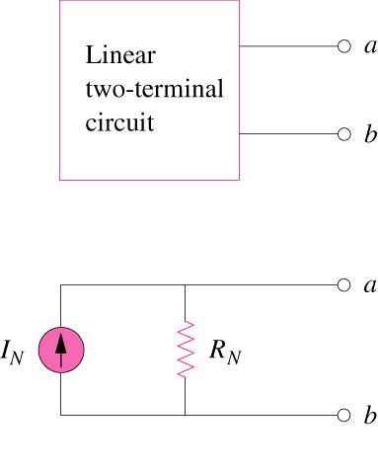
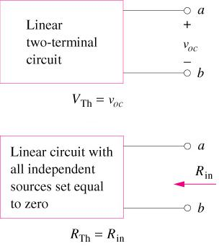
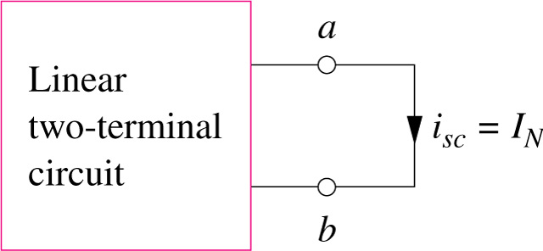
Norton’s Theorem
Norton equivalent circuit

Slide 33
Example

Slide 34
Norton's Theorem
Norton’s equivalent circuit can be found by transforming the Thevenin equivalent into a current source in parallel with the Thevenin resistance. Thus, the Norton equivalent circuit is given below.
Formally, Norton’s Theorem states that a linear two terminal resistive circuit can be replaced by an equivalent circuit consisting of a current source I_{N} in parallel with a resistor R_{N}, where I_{N} is the short-circuit current through the terminals, and R_{N} is the input or equivalent resistance at the terminals when all independent sources are all turned off.

Slide 35
Independent Sources (Thevenin)
R_{Th}
+
–
V_{oc}
Circuit with independent sources
Thevenin equivalent circuit

Slide 36
Thevenin ↔ Norton
Any Thevenin equivalent circuit is in turn equivalent to a current source in parallel with a resistor [source transformation]
A current source in parallel with a resistor is called a Norton equivalent circuit
Finding a Norton equivalent circuit requires essentially the same process as finding a Thevenin equivalent circuit

Slide 37
Independent Sources (Norton)
I_{sc}
R_{Th}
Circuit with one or more independent sources
Norton equivalent circuit

